Slide 1
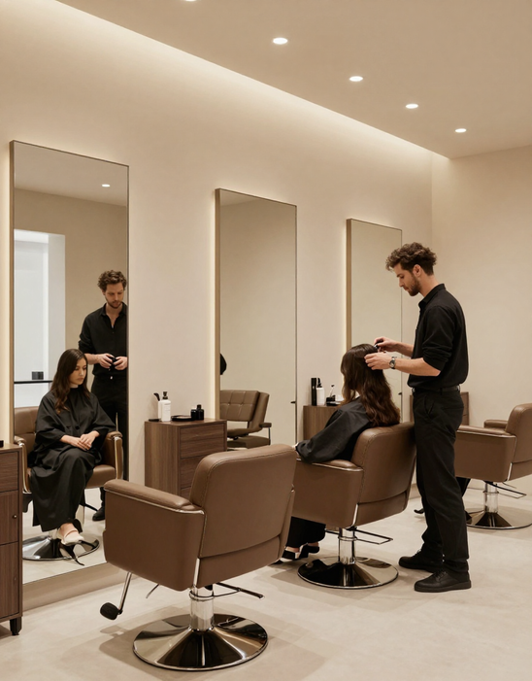

WELCOME
Smart Hair Care,
Perfect Matches
Personalized Hair Profiles & Intelligent Stylist Matching
Ahmed Yussuf

Slide 2

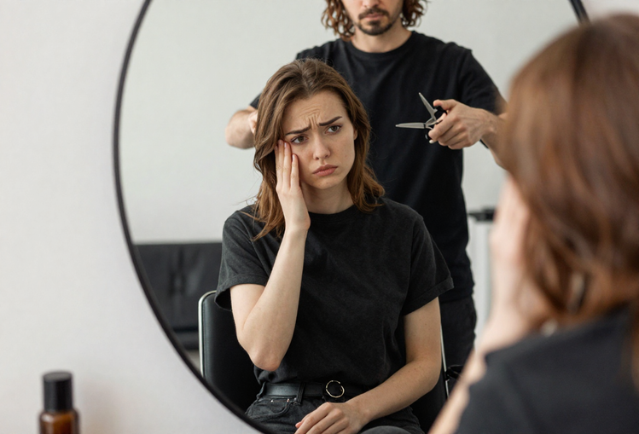


THE CHALLENGE IN HAIRCARE
Wrong Stylist Match
Wasted Time & Money
The
Finding the right hairstylist for your unique hair type and style is a real challenge. Without personalized service, customers often leave unsatisfied, wasting both time and money on results that don't match their needs.
Real Problem
Generic salon experiences ignore individual hair texture, scalp conditions, and personal style goals. The lack of smart matching between clients and specialists leads to repeated disappointment and lost loyalty.

Slide 3

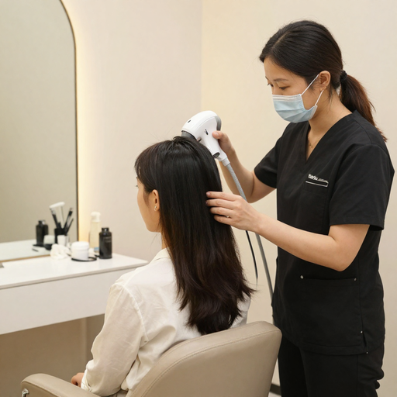
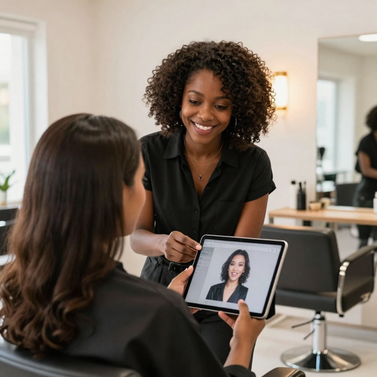
FACIAMATCH HAIR SALON
ONLINE BOOKING & SCANNING
PERSONALIZED MATCHING
Book appointments online with ease and flexibility. Upon arrival, a full head and scalp scan captures detailed hair data — type, texture, and health — to build your unique hair profile.
FaciaMatch uses your personalized hair profile to intelligently connect you with the stylist best suited to your hair type and needs, ensuring expert care every visit.
Always honest
Introducing
FaciaMatch
Amazing
care

Slide 4
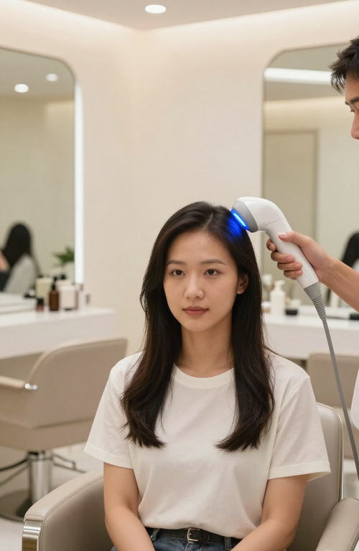
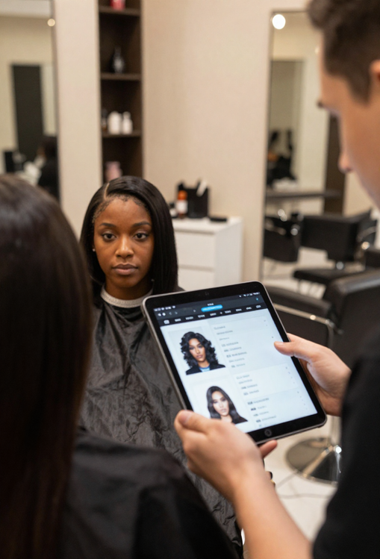
FACIAMATCH HAIR SALON
Online Booking & Scalp Scanning
Book appointments online with ease and undergo a full head & scalp scan for detailed hair analysis upon arrival.
Smart Matching & Hair Profiles
Receive a personalized hair profile capturing your hair type, texture, and needs — matched with the ideal stylist and tailored product recommendations.
Key
Features

Slide 5
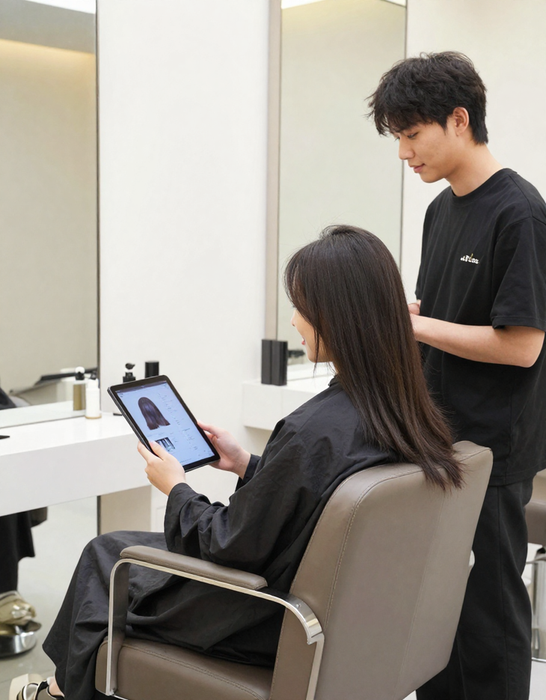
FACIAMATCH HAIR SALON
Customer
Journey
Browse salons, choose your preferred stylist, and book your appointment online at your convenience. Arrive at the salon and complete a full head and scalp scan for a detailed hair and scalp analysis.
01
Receive your personalized hair profile and get matched with the ideal stylist. Enjoy a tailored service, get hairstyle and product recommendations, and have your history saved for optimized future visits.
02

Slide 6
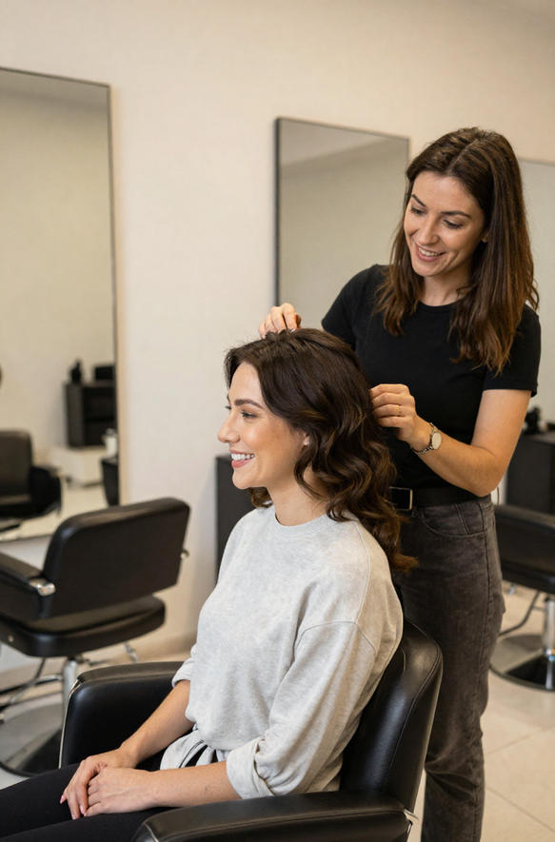
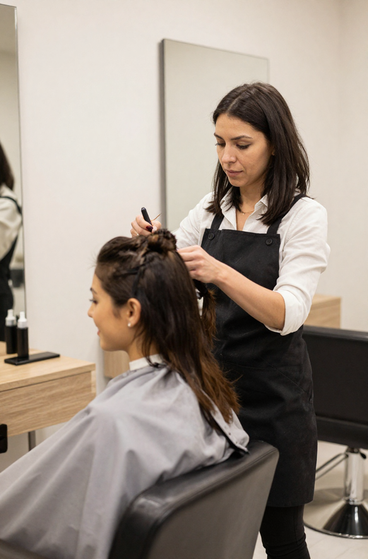
FACIAMATCH HAIR SALON
Key
Benefits
05
06
PERSONALIZED EXPERT CARE
happy results
STYLIST-CLIENT MATCH

Slide 7

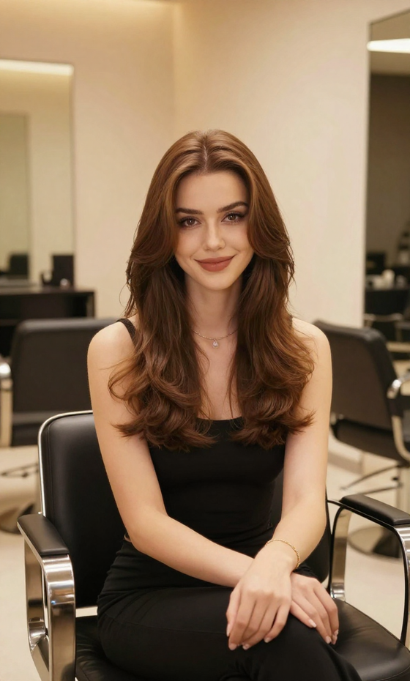
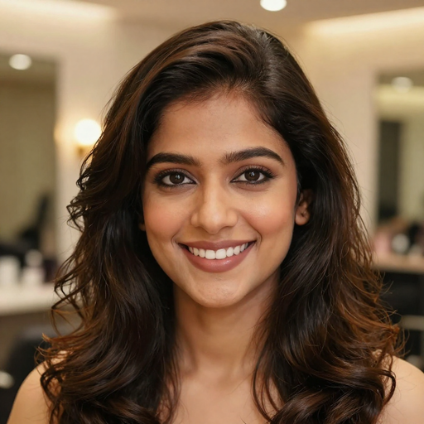
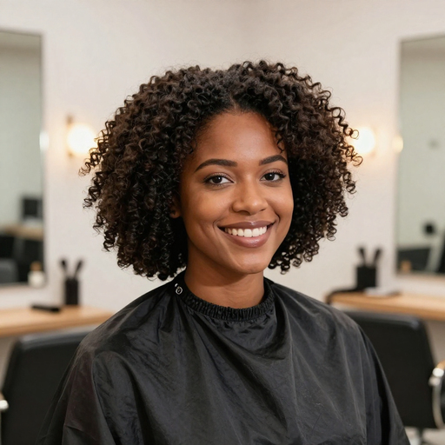
FACIAMATCH HAIR SALON
Transform
Your Salon Experience
Schedule a demo or partner with us:
www.faciamatch.com
contact@faciamatch.com
+1 (800) 324-2628

